Slide 1
Namma Yatri
Technical Strategy
Presentation by Ambar Chaudhari

Slide 2
Objective
Technical guide for
Operational efficiency
Proper recourses allocation
Improve customer satisfaction
For Namma Yatri services

Slide 3
Introduction
Good operation efficiency reduce cost and improve customer satisfaction
We must allocate our resources like taxi, auto and driver effectively so it will reduce waiting time and reduce cancellation from customer.
Every customer must get estimate and quote if he did not get it hewill not be able to continue further.

Slide 4
Operational issues
We have lost 18.65% of rides because customer did not get the estimate
Out of which only 82.76% customer searched for quotes.
After that we lost 12.23% of customer they did not get quotes.
Then we have 12.29% cancelation by customers.
Reducing our average conversation rate to 45.49%

Slide 5
Estimated price calculation
Make an robust system calculate the estimation of route quickly taking in consideration factors like distance between source and destination, traffic in that route, estimated time needed to reach that location and toll
Calculate using following formula
Formula for waiting charge is
Estimated waiting charge = (Estimated time including traffic -(Distance/Average speed) ) * waiting charge
Formula for estimated price is
Estimated price = Fixed price + (Distance in Km * Price per Km) + Estimated waiting charge + toll +night charge

Slide 6
Quote issue
12% of customer did not got quote
Why customer not getting quotation ?
Drivers might be unavailable in that that location,
Cabs are operating away from that route.
Check for technical glitches.
We must solve above issue as soon as possible as it affect revenue.

Slide 7
Cancelation by customers
The reason for cancelation of cabs from customers are from operational point of view.
Long Waiting Times: Customers cancel when the driver is too far, taking too long to arrive, or not moving towards the pickup point.
High Surge Pricing: Customers cancel when fares spike during peak hours, often seeking cheaper alternatives.

Slide 8
Solution for customer calculation
Allocate resources in efficient manner.
Avoid stopping the vehicle in customer's screen keep it slightly moving so customer will not cancel out of frustration.
Avoid huge surge in price once customer got the quote unless there are some unexpected events.

Slide 9
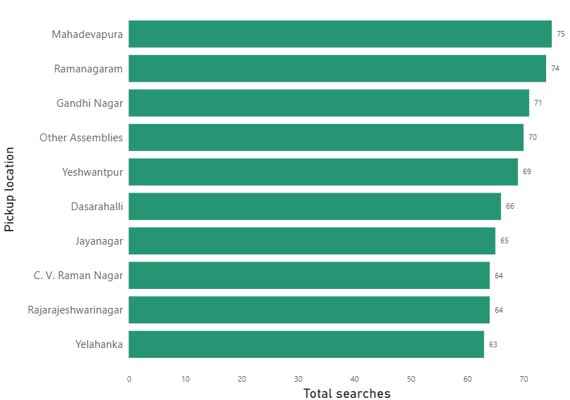
Allocation of resources
Following are the most searched pickup location
Mahadevapura
Yelahanka
Rajarajeshwarinagar
C. V. Raman Nagar
Jayanagar
Yeshwantpur
Dasarahalli
Other Assemblies
Gandhi Nagar
Ramanagaram
We must have estimate ready for these location so there is no dorp of for estimation

Slide 10
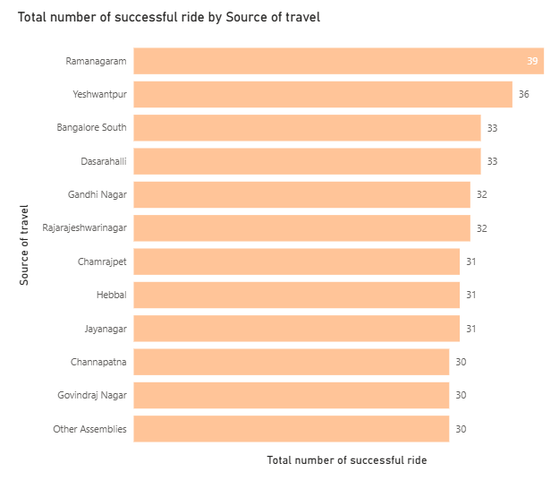
Cab availability
Estimated price calculation
These are most pick up location with successful rides
Ramanagaram
Yeshwantpur
Bangalore South
Dasarahalli
Gandhi Nagar
Rajarajeshwarinagar
Hebbal
Jayanagar
Govindraj Nagar
Other Assemblies

